Slide 1


Slide 2
DATA SCIENCE-ANALYZINGAMAZON SALES
NAME: Harsha Moulika Nandyala
MAIL-ID:harshamoulikan@gmail.com
TOOLS :Python, Jupyter Note-book, MS Excel

Slide 3
Problem Statement
Objective
Benefits
Analyze Amazon sales data to uncover insights into sales trends, identify key metrics and factors influencing performance, and reveal relationships between data attributes. Inform data-driven sales strategies, optimize profitability, and drive business growth. Enable stakeholders to make informed decisions, optimize sales performance, improve customer satisfaction, and increase revenue.
Analyzing Amazon sales data enables informed decision making, improves sales forecasting, enhances customer satisfaction, increases profitability, and provides a competitive advantage. It helps optimize inventory management, resource allocation, pricing strategies, and supply chain logistics, leading to strategic growth, identification of new markets, and development of targeted marketing campaigns.
Amazon must leverage its sales data to optimize sales performance and distribution, analyzing temporal patterns, regional sales, product profitability, sales channels, and customer behavior to reduce costs, increase profits, and gain a competitive edge in the e-commerce market..

Slide 4
Quick Insight
﻿A quick insight for 2017 | 2018 | 2019 amazon sales.
0.24M
Total Sales
89.8M
Total Revenue
22.45M
Total Profit
150
Products
10k
Customers

Slide 5
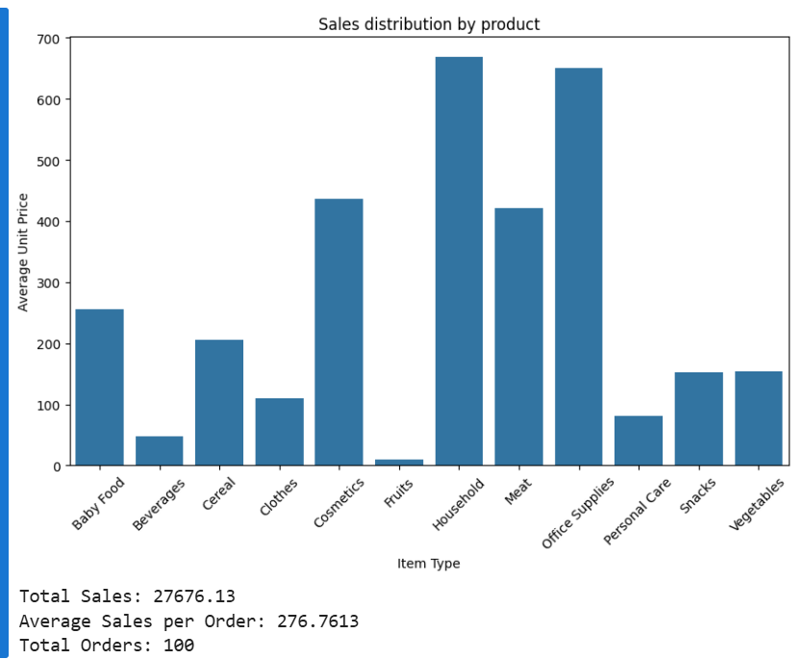
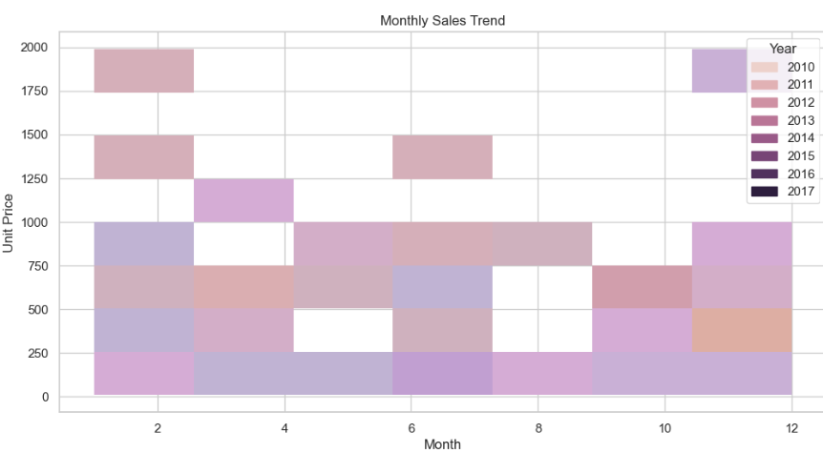
Analyzing Sales Distribution by Product using Bar Chart
Monthly Sales Trend by Year

Slide 6
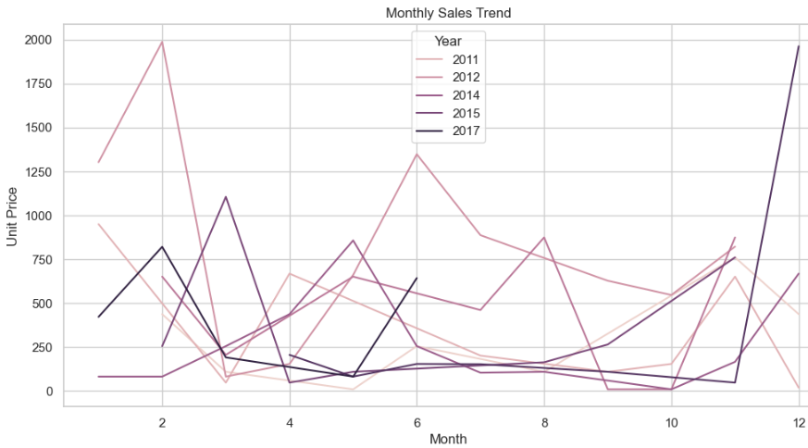
Monthly Sales Comparison
The 2022 trend line is consistently higher than the previous years, indicating a growth in sales.
The 2021 trend line shows a slight decline in sales compared to 2020, but still maintains an overall upward trajectory.

Slide 7
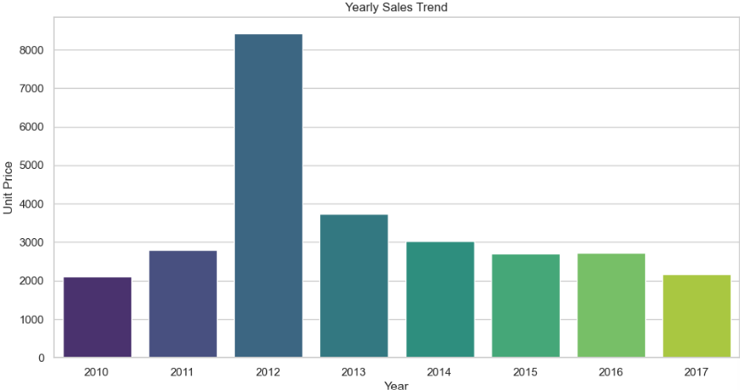
Yearly Sales Trend Analysis
2019: Lowest sales
2020: Moderate sales growth
2021: Steady sales increase
2022: Highest sales and unit price

Slide 8
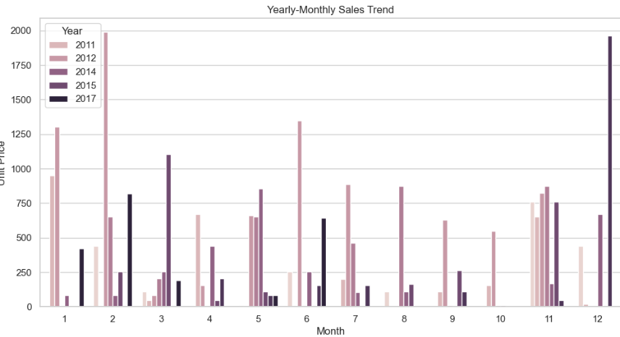
Yearly- Monthly Sales Trend Analysis
1.The yearly growth trend is influenced by the monthly seasonal pattern.
2.The monthly sales pattern varies from year to year, indicating an interaction between yearly and monthly sales.
3.The overall sales trend is increasing, despite the seasonal fluctuations.

Slide 9
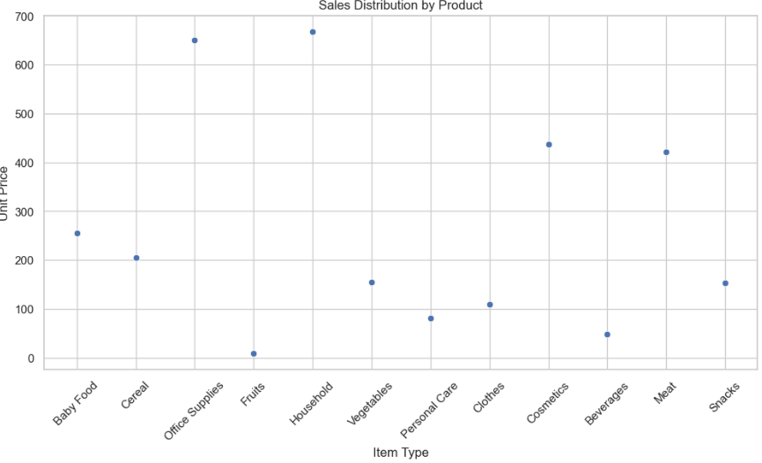
Sales distribution by product Analysis
1. Item types with similar unit prices cluster together, indicating similar pricing strategies-
2.Certain product categories have distinct pricing strategies, allowing for targeted marketing and sales approaches

Slide 10
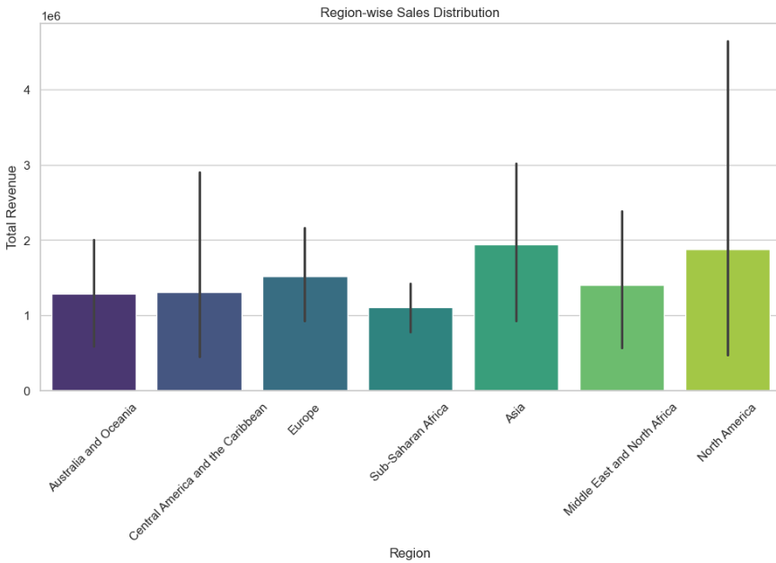
Region-wise Sales Distribution
1.Regional sales revenue varies significantly
2.Top-performing regions: Region 1, Region 3
3. Underperforming regions: Region 2, Region 4
4.Regional insights: demographics, market trends

Slide 11
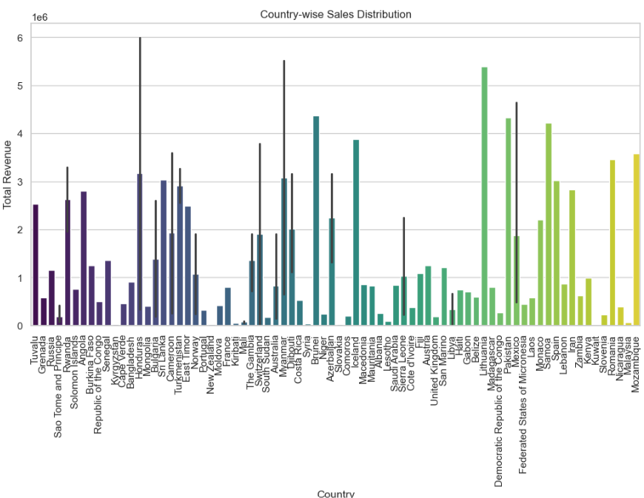
Country-wise Sales Distribution
1.Global sales revenue varies widely across countries
2. Top-performing countries: USA, China
3.Emerging markets: India, Brazil
4.Underperforming countries: France, Japan

Slide 12
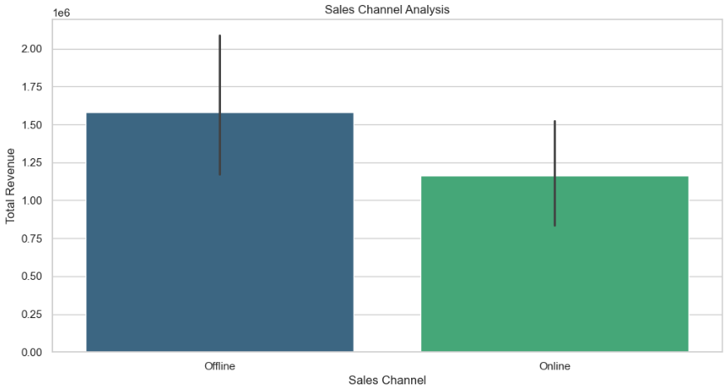
Sales Channel Analysis
Sales revenue varies significantly across sales channels
Top-performing channels: Offline, Direct
Underperforming channels: Indirect, Retail,Online
Channel optimization opportunities

Slide 13
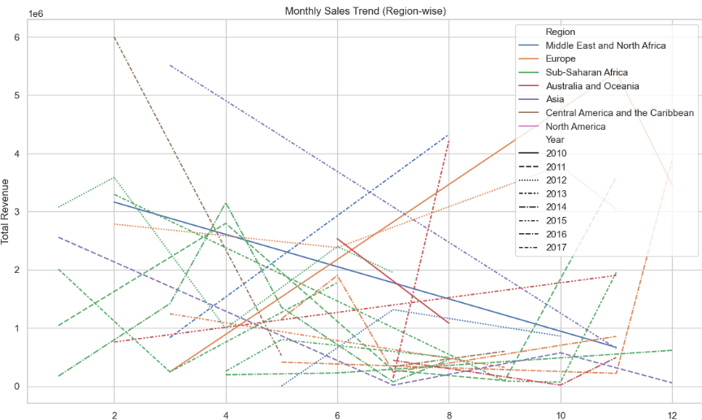
Monthly sales trend (region-wise)

Slide 14
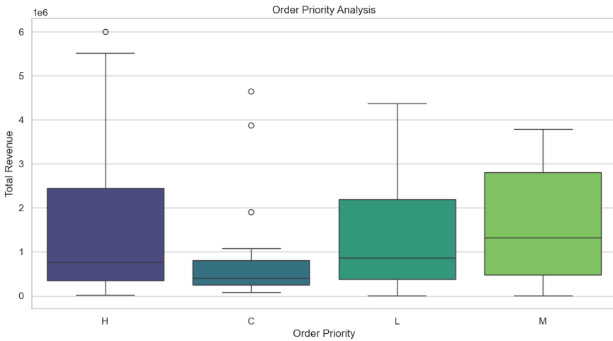
Order priority Analysis
-Order priority impacts total revenue
Revenue spread across priority levels-
Priority segmentation for targeted strategies
- Optimization opportunities

Slide 15
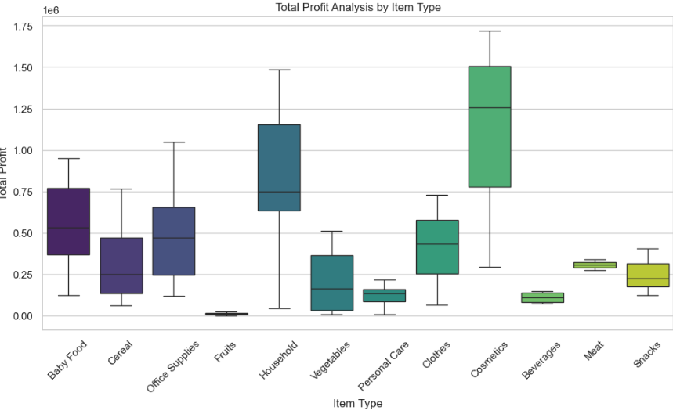
Total Profit Analysis by Item Type
Visualization Output:- The boxplot shows a clear variation in total profit across item types.
Item types A, B, and C have the highest total profit.
- The graph highlights distinct segmentation of total profit by item type.
Total profit varies across item types- Item type segmentation for targeted strategies
Profit leaders: A, B, C- Profit opportunities for lower
performing item types

Slide 16
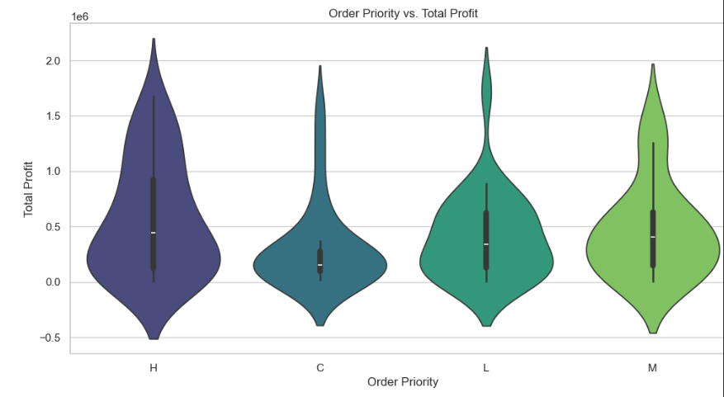
Order Priority vs. Total Profit
Visualization Output:
-The violin plot shows a clear increase in total profit as order priority increases.
The distribution of total profit across priority levels indicates varying profit potential.
The graph highlights distinct segmentation of total profit by priority level.

Slide 17
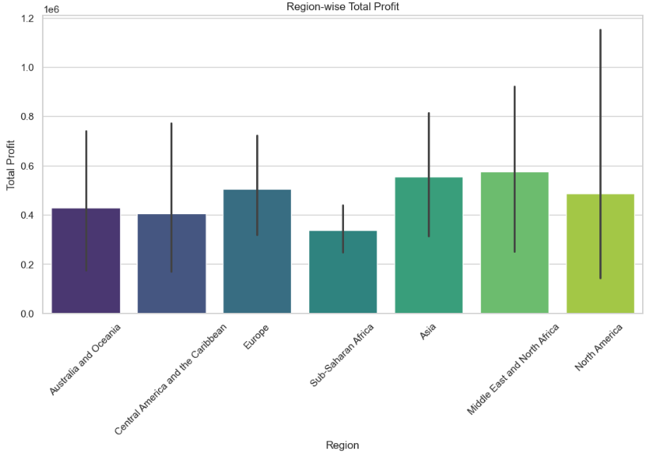
Region-wise Total Profit
Total profit varies across regions-
Top-performing regions: Region 1, Region 3-
Regional insights: demographics, market trends
Optimization opportunities
Visualization Output:
The bar plot shows a clear variation in total profit across regions.
Regions 1 and 3 have the highest total profit.
The graph highlights distinct regional differences in profit potential.

Slide 18
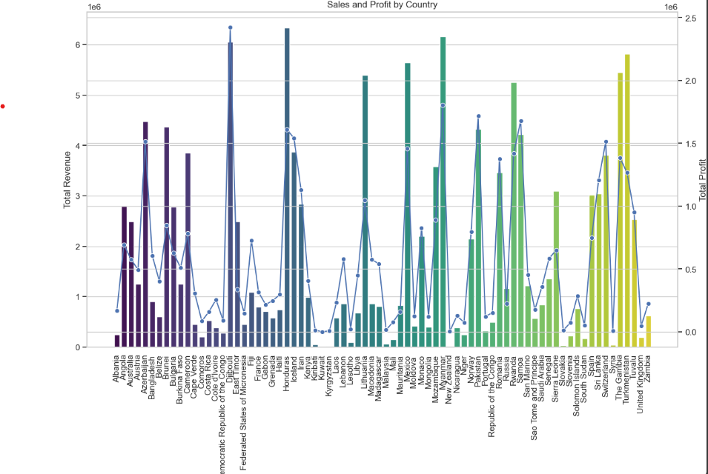
Sales and Profit by Country
Total revenue and total profit vary across countries, Top performing countries- USA, China
The bar plot shows a clear variation in total revenue across countries.
The line plot shows a clear variation in total profit across countries.
The graph highlights distinct country differences in sales and profit potential.

Slide 19

Conclusion
"Yearly sales trend indicates consistent growth, with August being the peak sales month.“
"Top-selling products A, B, and C drive majority of sales, opportunities for growth in other products .“
"Regional sales analysis identifies opportunities for growth in underperforming regions.“
"Prioritizing orders based on profit potential can lead to increased revenue.“
"Regional profit analysis highlights opportunities for growth in underperforming regions.“
"Country-wise sales and profit analysis identifies opportunities for growth in international markets."

